Slide 1
Santa Cruz County CERT Beginning MURS Training

Slide 2
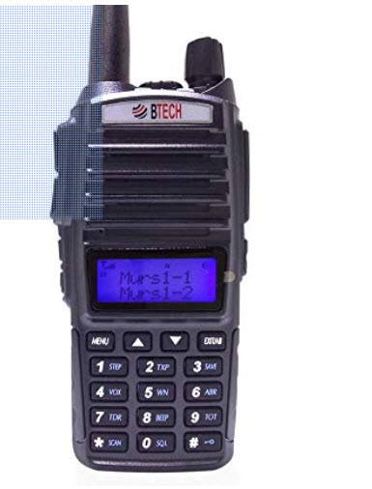
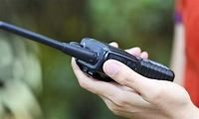
Why?
Why radios for CERT?
Why have your own radio ?
Why this radio?
Why the CERT programming?

Slide 3
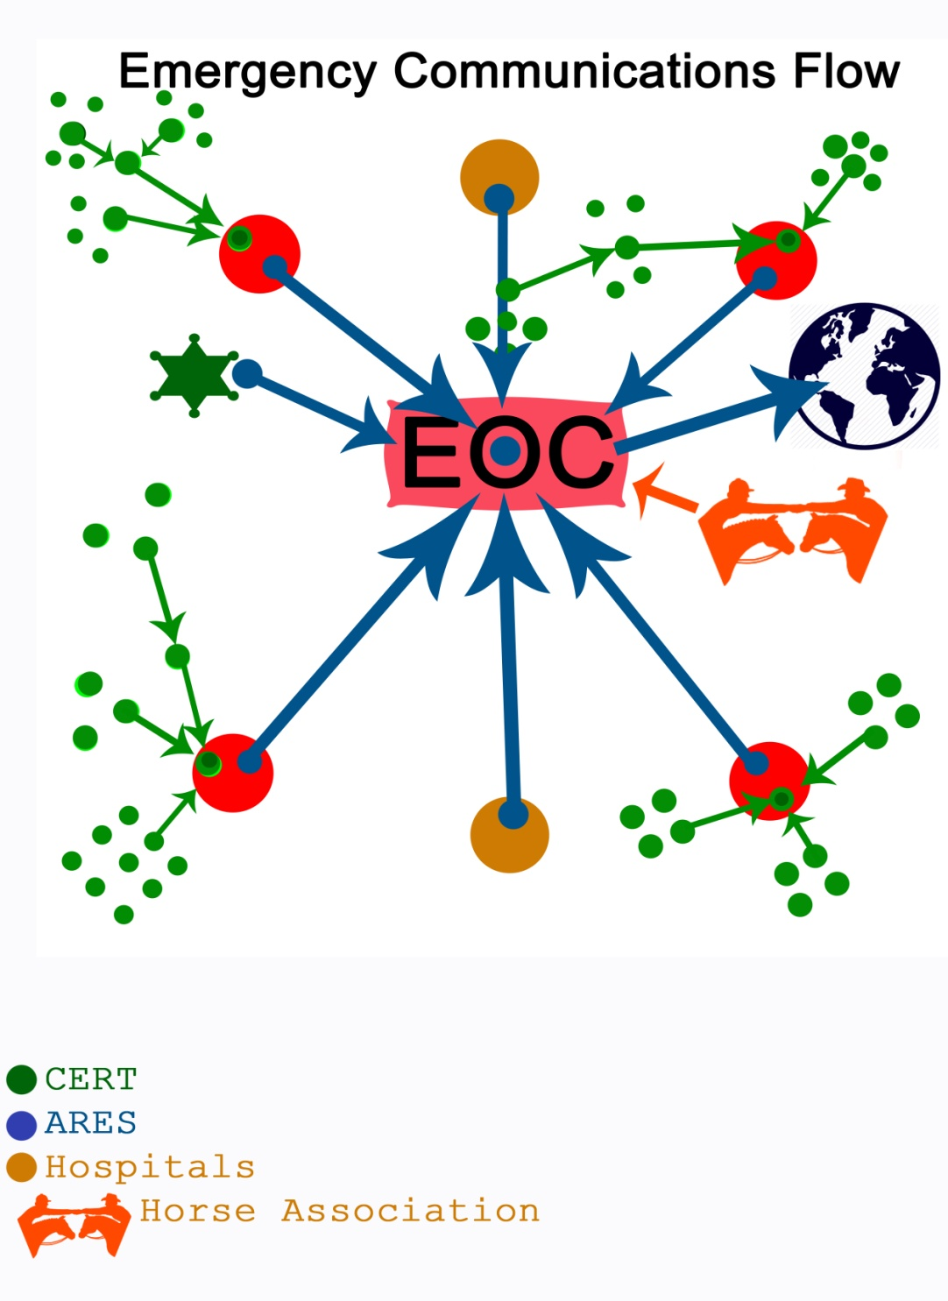
CERT Squad Members are Critical to Emergency Communication in a Disaster
BOOTS ON THE
GROUND !!

Slide 4
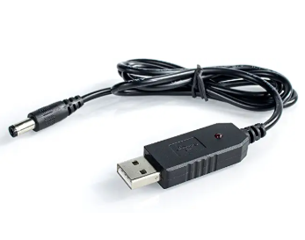
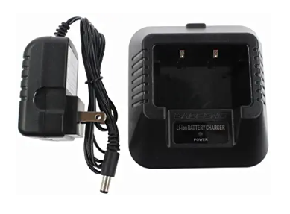
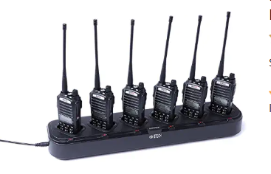
Radio Maintenance
Your Radio, Your Responsibility !
Assemble the radio – belt clip, strap, antenna - follow the manual
**************KEEP YOUR BATTERY CHARGED**************

Slide 5
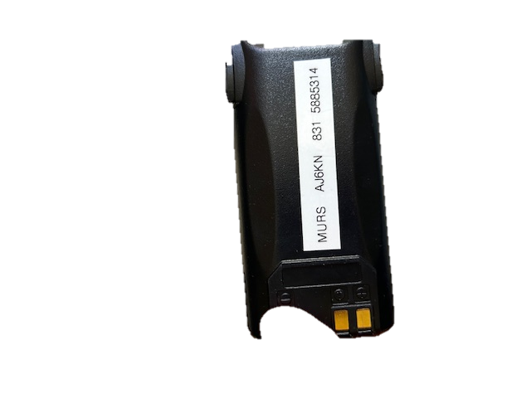
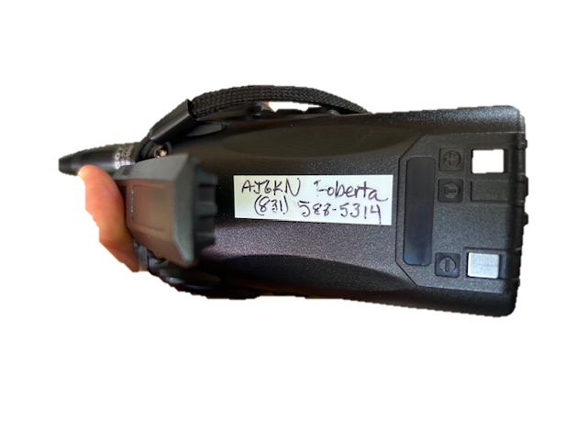
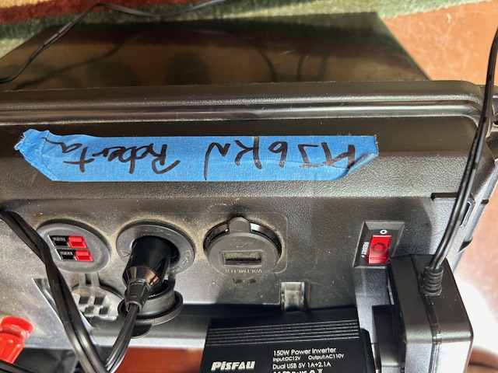
Label your stuff
Anything is better than nothing . . .

Slide 6
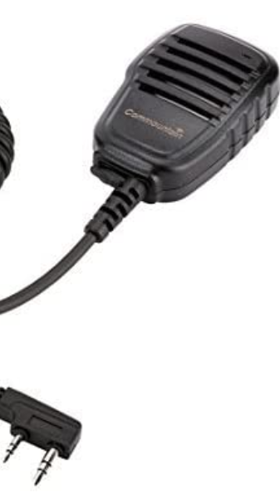
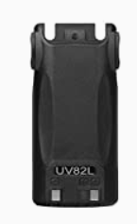
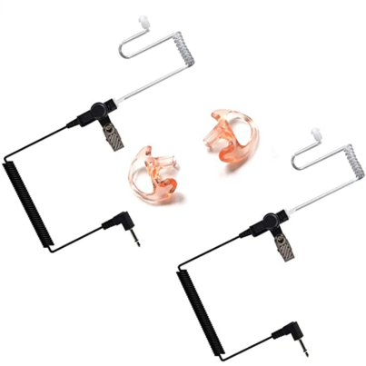
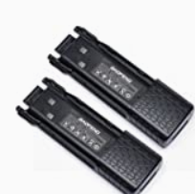
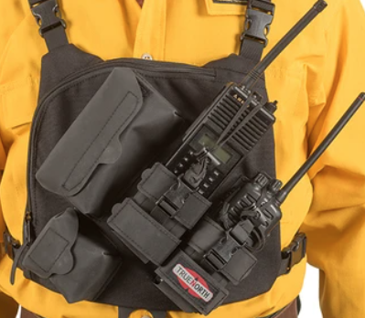
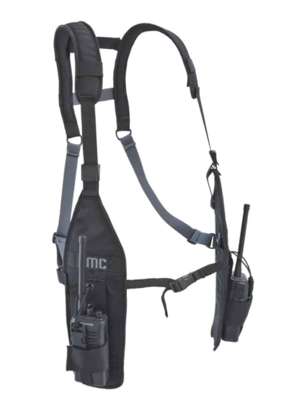
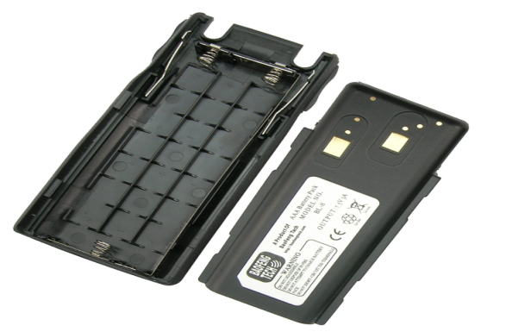
Accessories
Replacement Battery
Highly Recommended
Spare Battery +
Speaker Mike
Nice to Have
Clamshell AAA Battery Pack
Earpiece
Vest or Harness, Clip for Vest
External or Mag Mount Antenna
Speaker Microphone
Extended battery
Earpiece on Microphone
AAA Batteries
Radio Vest

Slide 7
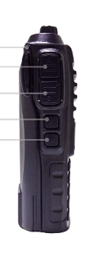
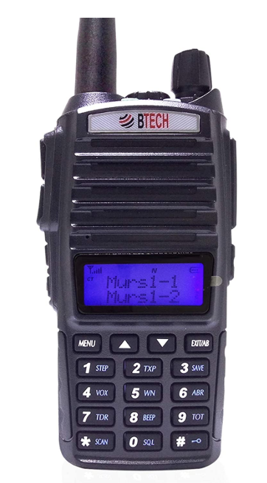
RADIO OPERATION
1
1) Turn On – Volume Set
2) Push To Talk ( PTT)
A (top) and B (bottom)
3) Two Channel Display
4) Activity Lights
Transmit –Red
Receive – Green
4
2
2
3
Battery
Notes:
Turn on – Channel Mode Volume

Slide 8
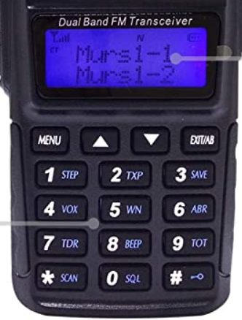
Operation
To Change Channels
# Lock ( or unlock ) the KeyBoard
Look for the triangle- that is the channel you will change .
Use the up or down arrows to change.
Use the Exit/AB button to move the triangle to the other channel
Notes:
Counts to 9 then One Zero ( 10) One One ( 11)

Slide 9
Operation
Incoming Signal Strength
Narrow Band
Battery
Channel
Display
Important to Improve Communication
Holding the Radio
Holding the microphone
Listening !!!
Tone Squelch

Slide 10
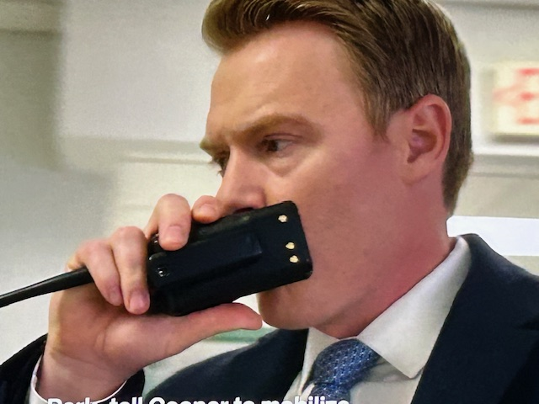
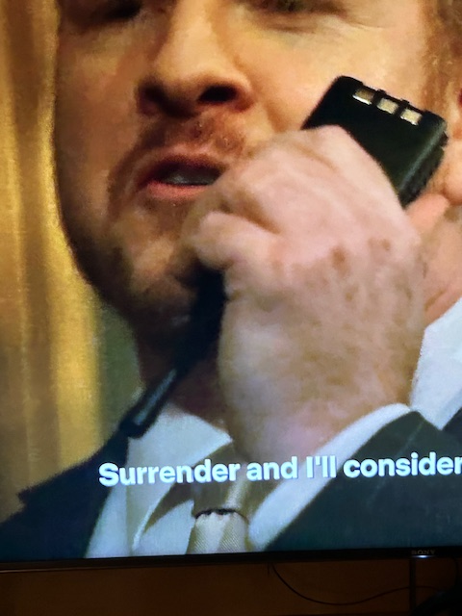
Wrong way to hold the radio . . .

Slide 11
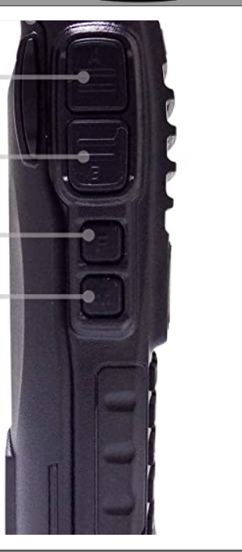
Other Radio Functions
F Button
Quick Push –
FM Radio –On/Off
Push and Hold (for a moment)–
Siren Alarm
M Button
Quick Push -
Cycle flashlight through steady/
strobe/off
Push and Hold ( for a moment )
Open Receive squelch
F
M

Slide 12
Etiquette Some One Else Is Listening
MURS RADIOS ARE FOR PROFESSIONAL PURPOSES
Do NOT
Yell, Shout, Whistle, Make Noises
Do Not Curse
Do Not Play Music or Sing
Children must be supervised
DO Speak slowly and clearly in a normal voice
Pause and listen between transmissions
Keep your messages short and on point

Slide 13
Protocol
To Contact
1) Listen! Is someone already talking?
If Yes-Is your message an emergency or priority?
If Yes – Say “Emergency” in a pause. You should be given the channel to use.
If No - Wait until they are done
2) Listen! Is someone already talking?
If No – Say the name or tactical identifier* you want to contact and then say yours . Wait for them to answer. If they don’t answer after a minute or so, call again.
* tactical call- an identifying name of a function or location used instead of a personal name.

Slide 14
Protocol
To Answer –
When you hear someone call you by name or tactical call, respond only with your name or call. Wait to hear their message. Then transmit your information.
If you are not heard; - Try again
- Hold your radio higher
- Change your location
- Ask for a Relay *
* A Relay is a person who can hear two parties who cannot hear each other. They assist by letting both parties know that they will relay and then communicating the messages between the parties. In some instances, multiple relay people may be needed to move information over a long distance or difficult terrain.

Slide 15
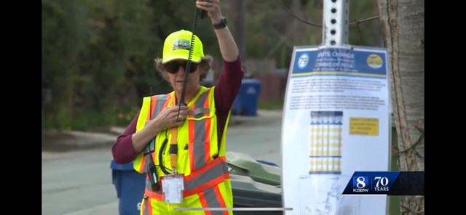
“Statue of Liberty” pose

Slide 16
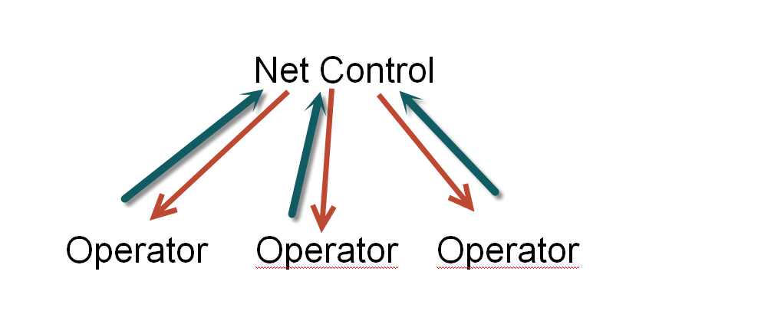
What is a NET? Think ICS
Most CERT communication will be directly from one person to another. Sometimes there may be several people using the same channel who will need to take turns.
If too many people are trying to talk on the same channel- one person should establish Net Control. They will function as a communications Team Leader. They determine who will speak and in what order. Members speak only as called upon by Net Control after identifying their presence. All information goes through Net Control unless the Net Control indicates two members can communicate directly with each other.

Slide 17
What Can Go Wrong?
I can’t hear anyone!
Check the volume
Check the channel
Check the battery icon
Turn the radio off and back on – does it talk to you? “ Channel Mode”
Check that the battery is fully installed
Using a speaker mike? Make sure it is completely plugged in.
There is a lot of noise- QRN/QRM
Voices are garbled and not understandable

Slide 18
Emergency Message Passing
Have a pen and paper, or have a scribe.
Be calm, pay attention and speak slowly
Acknowledgment of contact
First – who is reporting and where the emergency is.
What is the problem- Brief - Fire? Medical? Vehicle Accident?
After initial information- details of problem and location
ONLY COMMUNICATE WHAT YOU KNOW

Slide 19
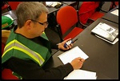
Practice – Practice –Practice !!!
Find Users in your Area to talk to.
Join Team Radio exercises
Use Radios at Team Zoom meetings to practice protocol even if you can’t hear each other on the radio. ( you never know who you might hear)
Thank You For Serving Your Community as CERT by providing Essential Emergency Communications !!!!

